Slide 1
VEHICLE DAMAGE DETECTION SYSTEM
MENTOR: Ms.K.B.Mirra AP/CSE
TEAM MEMBERS: Lavanya A M (1912075)
Roshini S (1912096)
Siva Nandhini M (1912107)

Slide 2
AGENDA
Abstract
Literature Survey
Proposed Methodology
Proposed Architecture
Modules
System Requirements
Conclusion
References

Slide 3
ABSTRACT
The growth of the automobile industry today is closely tied to the rise in vehicle accidents.As a result, insurance firms are addressing claims leakage while dealing with numerous concurrent claims.These problems for the insurance sectors can be resolved with the aid of artificial intelligence (AI) based on deep learning models.
For the purpose of assessing and detecting automotive damage in real-world datasets, we use a deep learning-based model.The model identifies the damaged area of a car, converts the image to grayscale, determines its location, then determines how severe it is, and employs several ways to increase the system's accuracy.Additionally, it identified the damage's accuracy in percentage terms, which will aid in determining the extent of the damage to the car.

Slide 4
it identified the damage's accuracy in percentage terms, which will aid in determining the extent of the damage to the car.
The approach taken in this project involves applying techniques that have been proven effective for a number of image classification issues to the specific issue of visually identifying automotive damage before comparing the results to those of other approaches already in use.

Slide 5
LITERATURE SURVEY
S.NO | PAPER NAME | JOURNAL TYPE & YEAR OF PUBLICATION | AUTHORS | OBJECTIVE AND WORK DONE IN THE PAPER
1 | Accident Detection Using Convolutional Neural Networks | IEEE & published on 29 August 2019 | Sreyan Ghosh, Rohan Roney, Sherwin Joseph Sunny. | In highways where the traffic is really light and fast-paced an accident victim could be left unattended for a long time. The intent is to create a system which would detect an accident based on the live feed of video from a CCTV camera installed on a highway. The idea is to take each frame of a video and run it through a deep learning convolution neural network model which has been trained to classify frames of a video into accident or non-accident. Convolutional Neural Networks has proven to be a fast and accurate approach to classify images. CNN based image classifiers have given accuracy's of more than 95% for comparatively smaller datasets and require less preprocessing as compared to other image classifying algorithms.

Slide 6
S.NO | PAPER NAME | JOURNAL TYPE & YEAR OF PUBLICATION | AUTHOR | OBJECTIVE AND WORK DONE IN THE PAPER
2 | Vehicle Detection Using Convolutional Neural Network for Autonomous Vehicles | IEEE & Published on November 2018 | Izzah Amani Tarmizi | This paper implements a region identification to automatically detect vehicles on the road using Convolutional Neural Network (CNN) for autonomous vehicles. The region identification is essential to ensure the autonomous vehicle can safely navigate without having collision with other vehicles. Existing works highlighted the problem of poor detection in autonomous vehicles (AV) during night scene and in bad weathers. This paper develops a technique to improve the detection of vehicles during night scene (poor lighting condition) and bad weathers using CNN approach.

Slide 7
S.NO | PAPER NAME | JOURNAL TYPE & YEAR OF PUBLICATION | AUTHORS | OBJECTIVE AND WORK DONE IN THE PAPER
3 | A Very Deep Transfer Learning Model for Vehicle Damage Detection and Localization | IEEE & published on MARCH 2020 | Hakim Ghazzai, Yehia Massoud, Hichem Besbes, Najmeddine Dhieb. | Claims leakage is a major problem engendering tremendous losses for insurance companies. With the huge advances in Artificial Intelligence (AI), machine and deep learning algorithms, those technologies have started being used in insurance industry to solve such problems and cope with their negative consequences. In this paper, we propose automated and efficient deep learning-based architectures for vehicle damage detection and localization. Its objective is to automatically detect damages in vehicles, locate them, classify their severity levels, and visualize them by contouring their exact locations.

Slide 8
S.NO | PAPER NAME | JOURNAL TYPE & YEAR OF PUBLICATION | AUTHORS | OBJECTIVE AND WORK DONE IN THE PAPER
4 | Automated Damage Detection in Operational Vehicles Using Mask R-CNN | Springer & published on 07 May 2020 | Naeem Patel, Freddy Poly. | One of the important aspects of day-to-day life is transportation and there is a huge surge in the number of accidents every year due to the negligence of the vehicle conditions. Human errors during the inspection are another major concern. Hence, to improve the quality of testing of vehicles, we have come up with a solution that could detect anomalies in the vehicle due to negligence. This paper describes a solution to vehicle damage detection by the use of convolutional neural networks (CNN) to detect and highlight faults such as bumps, dents, and scratches to the vehicle’s outer body. Primarily, Mask R-CNN, an avant-garde algorithm for object detection, localization and instance segmentation of natural images to solve the above problem in a quick and efficient manner.

Slide 9
S.NO | PAPER NAME | JOURNAL TYPE & YEAR OF PUBLICATION | AUTHORS | OBJECTIVE AND WORK DONE IN THE PAPER
5 | Car Damage Analysis for Insurance Market Using Convolutional Neural Networks | Springer & published on 6th July 2019 | C.T.Artan, Tolga Kaya . | As the level of competition increases, image-based vehicle claim processing is gaining an important role in the insurance industry especially in handling small but more frequent insurance claims. In this study, we explore the applicability of Convolutional Neural Networks (CNNs) to determine the level of damage using damaged car images. We have used transfer learning to analyze the advantages of available object recognition models to detect and classify damage according to the damage area and the level of damage.

Slide 10
S.NO | PAPER NAME | JOURNAL TYPE & YEAR OF PUBLICATION | AUTHORS | OBJECTIVE AND WORK DONE IN THE PAPER
6 | Deep Learning-Based Car Damage Classification and Detection | Springer & published on 14th August 2020 | Mahavir Dwivedi, Hashmat Shadab Malik, S. N. Omkar, | In this paper, we worked on the problem of vehicle damage classification/detection which can be used by insurance companies to automate the process of vehicle insurance claims in a quick fashion. Using CNN models pre-trained on ImageNet dataset and using several other techniques to improve the performance of the system, we were able to achieve top accuracy of 96.39%, significantly better than the current results in this work. In addition to this, we also propose a pipeline for a more robust identification of the damage in vehicles by combining the tasks of classification and detection. Overall, these results pave the way for further research in this problem domain, and we believe that collection of a more diverse dataset would be sufficient to implement an automated vehicle damage identification system in the near future.

Slide 11
S.NO | PAPER NAME | JOURNAL TYPE & YEAR OF PUBLICATION | AUTHOR | OBJECTIVE AND WORK DONE IN THE PAPER
7 | ImageNet classification with deep convolutional neural networks | Communication of ACM & published on 24th May 2020 | Alex Krizhevsky, Ilya Sutskever, Geoffrey E. Hinton | In this Paper trained a large, deep convolutional neural network to classify the 1.2 million high-resolution images in the ImageNet LSVRC-2010 contest into the 1000 different classes. The neural network, which has 60 million parameters and 650,000 neurons, consists of five convolutional layers, some of which are followed by max-pooling layers, and three fully connected layers with a final 1000-way softmax. To make training faster, we used non-saturating neurons and a very efficient GPU implementation of the convolution operation. To reduce overfitting in the fully connected layers we employed a recently developed regularization method called "dropout" that proved to be very effective.

Slide 12
S.NO | PAPER NAME | JOURNAL TYPE & YEAR OF PUBLICATION | AUTHORS | OBJECTIVE AND WORK DONE IN THE PAPER
8 | Vehicle Damage Classification and Image Detection Using Deep Learning | IEEE & published on 19th November 2020 | Umer Waqas Nimra Akram | Image-based vehicle insurance processing and loan management has large scope for automation in automotive industry. In this paper we consider the problem of car damage classification, where categories include medium damage, huge damage and no damage. Based on deep learning techniques, MobileNet model is proposed with transfer learning for classification. Moreover, moving towards automation also comes with diverse hurdles; users can upload fake images like screenshots or taking pictures from computer screens, etc. To tackle this problem a hybrid approach is proposed to provide only authentic images to algorithm for damage classification as input. In this regard, moiré effect detection and metadata analysis is performed to detect fraudulent images. For damage classification 95% and for moiré effect detection 99% accuracy is achieved.

Slide 13
S.NO | PAPER NAME | JOURNAL TYPE & YEAR OF PUBLICATION | AUTHORS | OBJECTIVE AND WORK DONE IN THE PAPER
9 | Deep Learning based Car damage classification | IEEE & published on 18th January 2018 | Kalpesh Patil Anand Sriraman | In this paper we consider the problem of car damage classification, where some of the categories can be fine-granular. We explore deep learning based techniques for this purpose. Initially, we try directly training a CNN. However, due to small set of labeled data, it does not work well. Then, we explore the effect of domain-specific pre-training followed by fine-tuning. Finally, we experiment with transfer learning and ensemble learning. Experimental results show that transfer learning works better than domain specific fine-tuning. We achieve accuracy of 89.5% with combination of transfer and ensemble learning.

Slide 14
S.NO | PAPER NAME | JOURNAL TYPE & YEAR OF PUBLICATION | AUTHORS | OBJECTIVE AND WORK DONE IN THE PAPER
10 | Assessing Car Damage with Convolutional Neural Networks | IEEE & published on 12th August 2021 | Harit Bandi Suyash Joshi Siddhant Bhagat Amol Deshpande | Manual estimation of damages in fields like construction, vehicular accidents has been the mainstay of the insurance business. However, such methods are replete with biases and inaccurate estimations. This paper deals with estimating car damage, primarily with auto insurers as our key potential customers. For this purpose, three distinct Transfer Learning approaches are used which detect the presence of damage, location, and severity of the damage. The basis for algorithms used lies in Convolutional Neural Networks, customized to optimize accuracy. Each approach is analyzed and varying degrees of accuracy were achieved across different models deployed ranging from 68% to 87%. Accuracy as high as 87.9% was obtained during the course of experiments. This research fine-tunes a number of existing approaches and opens doors for collaboration in image recognition, particularly for the car insurance domain.

Slide 15
S.NO | PAPER NAME | JOURNAL TYPE & YEAR OF PUBLICATION | AUTHOR | OBJECTIVE AND WORK DONE IN THE PAPER
11 | Analysis of Car Damage for Personal Auto Claim Using CNN | Springer & published on 26th October 2021 | N.Advait | In the world of vehicle insurance and rental industries, detecting damages on vehicles is one of the most important activities. These damages are identified and inspected by the drivers and insurance companies to determine the suitable monetary compensation, and by vehicle rental companies to assign the responsibility to guilty customers. Since the current system is time consuming, wherein the inspectors have to manually inspect the damages before appraising, this identification can be performed by object recognition systems. The intricacy of these systems rests in the image feature determination and extraction techniques. A more novel approach to detecting the severity of damage and predicting the repair costs is using 2D image recognition.

Slide 16
S.NO | PAPER NAME | JOURNAL TYPE & YEAR OF PUBLICATION | AUTHORS | OBJECTIVE AND WORK DONE IN THE PAPER
12 | A Deep Learning and Transfer Learning Approach for Vehicle Damage Detection | Flairs & published on 18th April 2021 | Lin Li, Koshin Ono,Chun-Kit Ngan. | In this paper, Mask R-CNN is used for image segmentation to identify and crop vehicles from images. Then a convolutional neural network (CNN) model is built to classify whether or not the vehicles have damages. In addition, transfer learning is utilized in both image segmentation and classification phases to help build the models for vehicle detection and damage detection, using the pre-trained weights from Microsoft COCO dataset and ImageNet, respectively. 864 images of damaged vehicles collected from public websites, such as Google Images, are used in this research. The experiment on the detection of bumper damages has achieved 87.5% accuracy.

Slide 17
S.NO | PAPER NAME | JOURNAL TYPE & YEAR OF PUBLICATION | AUTHORS | OBJECTIVE AND WORK DONE IN THE PAPER
13 | Car Damage Detection and Cost Evaluation Using MASK R-CNN | Springer & published on 28th September 2021 | D.Malathi, Meha kanagarajan, Greeta Kavita Jayaraj, J.D. Dorathi Jayaseeli | Detecting the damage on a car is an image-based processing method with enormous scope for automation. This concept of automated detection of the extent of exterior damage on a car and subsequent quantification of the damage severity would benefit car insurers, car rentals and repair services. In this paper, we propose employing convolution neural networks to build a Mask R-CNN model that can detect the area of damage on a car. The dataset used consists of images of damaged vehicles with a single class named scratch. The images are precisely annotated with the area of damage. The model is trained using the base weights of Mask R-CNN COCO dataset. The images are processed for 21 epochs. After processing, the final result is visualized using a color splash technique, wherein the area of damage is highlighted. This model would help in reducing the cost of processing insurance claims and lead to greater customer satisfaction.

Slide 18
S.NO | PAPER NAME | JOURNAL TYPE & YEAR OF PUBLICATION | AUTHORS | OBJECTIVE AND WORK DONE IN THE PAPER
14 | Convolutional Neural Networks for vehicle damage detection | Science Direct & published on 15th September 2022 | S.Bhulai, R.E.van Ruitenbeek. | Vehicle damages are increasingly becoming a liability for shared mobility services. The large number of handovers between drivers demands for an accurate and fast inspection system, which locates small damages and classifies these into the correct damage category. To address this, a damage detection model is developed to locate vehicle damages and classify these into twelve categories. A performance evaluation with domain experts shows, that the model achieves comparable performance. In addition, the model is evaluated in a specially designed light street, indicating that strong reflections complicate the detection performance.

Slide 19
S.NO | PAPER NAME | JOURNAL TYPE & YEAR OF PUBLICATION | AUTHORS | OBJECTIVE AND WORK DONE IN THE PAPER
15 | A Deep Learning-Based Vehicles System for Accident Detection With Emergency Notification | IEEE & published on 09th October 2019 | Wan -Jung chang Liang-Bi chen | Most individuals involved in traffic accidents receive assistance from drivers, passengers, or other people. However, when a traffic accident occurs in a sparsely populated area or the driver is the only person in the vehicle and the crash results in loss of consciousness, no one will be available to send a distress message to the proper authorities within the golden window for medical treatment. This paper proposes a deep learning-based Internet of Vehicles (IoV) system called DeepCrash, which includes an in-vehicle infotainment (IVI) telematics platform with a vehicle self-collision detection sensor and a front camera, a cloud-based deep learning server, and a cloud-based management platform.

Slide 20
S.NO | PAPER NAME | JOURNAL TYPE & YEAR OF PUBLICATION | AUTHORS | OBJECTIVE AND WORK DONE IN THE PAPER
16 | Front-View Vehicle Damage Detection using Roadway Surveillance Camera Images | SCITEPRESS – Science and Technology Publications, 2019 | Burak Balci, Yusuf Artan, Bensu Alkan, Alperen Elihos. | Vehicle body damage detection from still images has received considerable interest in the computer vision community in recent years.Earlier studies utilized images taken from short proximity (< 3 meters) to the vehicle or to the damaged region of vehicle. In this study, The proposed method utilizes deep learning based object detection and image classification methods to determine damage status of a vehicle and combines the symmetry property of vehicles’ frontal view and transfer learning concept in its inference process. Experimental results show that the proposed method achieves 91 % accuracy on a test dataset.

Slide 21
S.NO | PAPER NAME | JOURNAL TYPE & YEAR OF PUBLICATION | AUTHORS | OBJECTIVE AND WORK DONE IN THE PAPER
17 | Vehicle Damage Classification and Fraudulent Image Detection Including Moiré Effect Using Deep Learning | IEEE & published on 19th November 2020. | Umer Waqas, Nimra Akram, Soohwa Kim, Donghun Lee, Jihoon Jeon. | Image-based vehicle insurance processing and loan management has large scope for automation in automotive industry. In this paper we consider the problem of car damage classification, where categories include medium damage, huge damage and no damage. Moreover, moving towards automation also comes with diverse hurdles; users can upload fake images like screenshots or taking pictures from computer screens, etc. To tackle this problem a hybrid approach is proposed to provide only authentic images to algorithm for damage classification as input. In this regard, moiré effect detection and metadata analysis is performed to detect fraudulent images. For damage classification 95% and for moiré effect detection 90% accuracy is achieved.

Slide 22
S.NO | PAPER NAME | JOURNAL TYPE & YEAR OF PUBLICATION | AUTHOR | OBJECTIVE AND WORK DONE IN THE PAPER
18 | Vehicle-Damage-Detection Segmentation Algorithm Based on Improved Mask RCNN | IEEE & published on 6th January 2020. | Qinghui Zhang, Xianing Chang, Shanfeng Bian Bian. | Traffic congestion due to vehicular accidents seriously affects normal travel, and accurate and effective mitigating measures and methods must be studied. To resolve traffic accident compensation problems quickly, a vehicle-damage-detection segmentation algorithm based on transfer learning and an improved mask regional convolutional neural network (Mask RCNN) is proposed in this paper. The experiment first collects car damage pictures for preprocessing and uses Labelme to make data set labels.The residual network (ResNet) is optimized, and feature extraction is performed in combination with Feature Pyramid Network (FPN).Finally, the results of self-made dedicated dataset training and testing show that the improved Mask RCNN has better Average Precision (AP) value, detection accuracy and masking accuracy, and improves the efficiency of solving traffic accident compensation problems.

Slide 23
S.NO | PAPER NAME | JOURNAL TYPE & YEAR OF PUBLICATION | AUTHOR | OBJECTIVE AND WORK DONE IN THE PAPER
19 | Damage Detection Sensitivity of a Vehicle-based Bridge Health Monitoring System | 12th International Conference on Damage Assessment of Structures on 12th July 2017 | Ayaho Miyamoto, Akito Yabe, Válter J. G. Lúcio. | As one solution to the problem for condition assessment of existing short and medium span (10-30m) reinforced/prestressed concrete bridges, a new monitoring method using a public bus as part of a public transit system (called "Bus monitoring system") was proposed, along with safety indices, namely, "characteristic deflection", which is relatively free from the influence of dynamic disturbances due to such factors as the roughness of the road surface, and a structural anomaly parameter. In this study, to evaluate the practicality of the newly developed bus monitoring system, it has been field-tested over a period of about four years by using an in-service fixed-route bus operating on a bus route.The verification results thus obtained are also described in this paper, and also evaluates the sensitivity of the "characteristic deflection", which is a bridge (health) condition indicator used by the bus monitoring system, in damage detection.

Slide 24
S.NO | PAPER NAME | JOURNAL TYPE & YEAR OF PUBLICATION | AUTHORS | OBJECTIVE AND WORK DONE IN THE PAPER
20 | A Machine Learning Approach to Bridge-Damage Detection Using Responses Measured on a Passing Vehicle | Published on 19 September 2019 at MDPI | Abdollah matekjatarian, Fatemeh Golpayegani, Callum Molleney. | A new two-stage machine learning approach for bridge damage detection using the responses measured on a passing vehicle. In the first stage, an artificial neural network (ANN) is trained using the vehicle responses measured from multiple passes.. The vehicle acceleration or Discrete Fourier Transform (DFT) spectrum of the acceleration is used. The vehicle response is predicted from its speed for multiple passes over the bridge. Root-mean-square error is used to calculate the prediction error. In the second stage of the proposed method, a damage indicator is defined using a Gaussian process that detects the changes in the distribution of the prediction errors. It is suggested that if the bridge condition is healthy. The performance of the proposed approach was evaluated using numerical case studies of vehicle–bridge interaction. It was demonstrated that the approach could successfully detect the damage in the presence of road roughness profile and measurement noise, even for low damage levels.

Slide 25
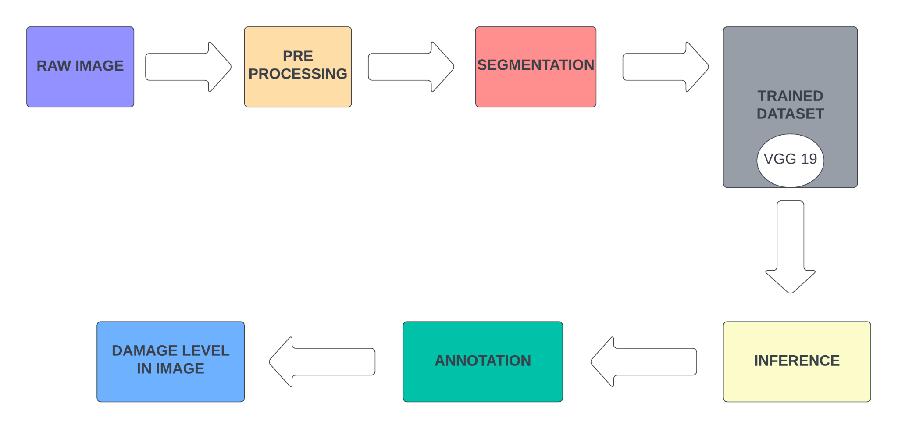
PROPOSED METHODOLOGY

Slide 26
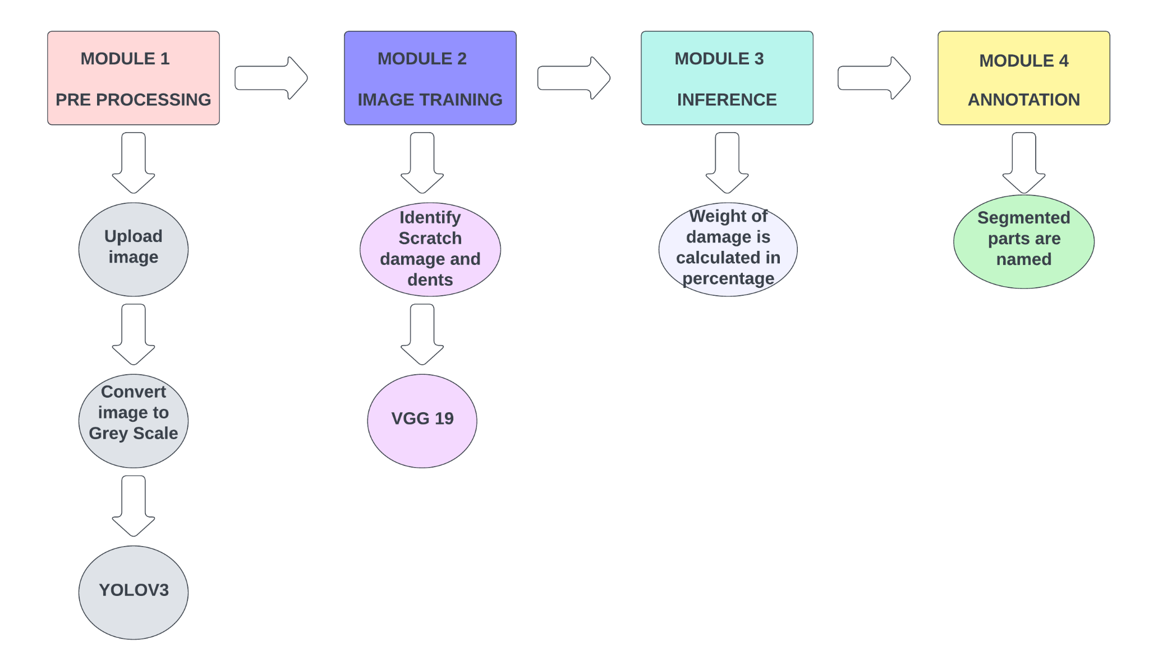
PROPOSED ARCHITECTURE

Slide 27
MODULES
Pre-Processing
Image Training
Inference
Annotation

Slide 28
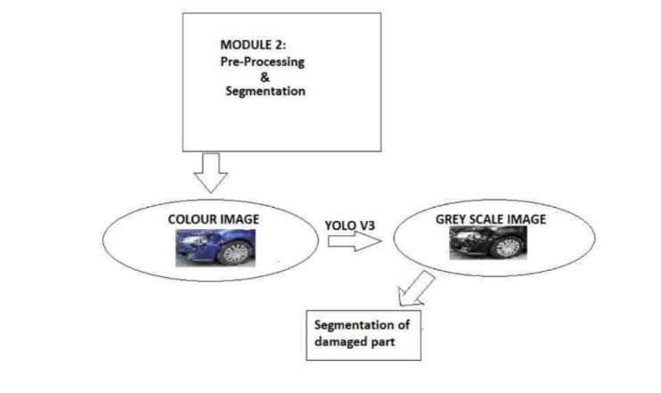
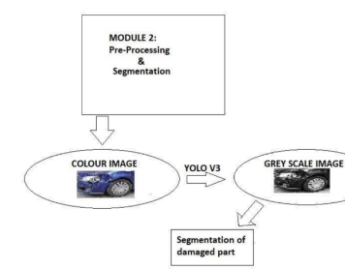
PRE-PROCESSING
YOLOV3

Slide 29
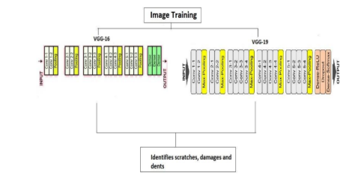
IMAGE TRAINING

Slide 30
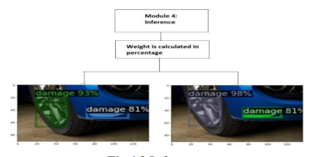
INFERENCE

Slide 31
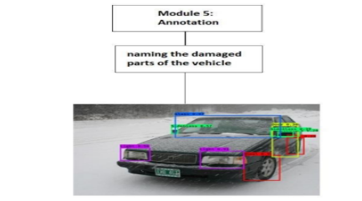
ANNOTATION

Slide 32
SYSTEM REQUIREMENTS
HARDWARE SPECIFICATION
Processor: Intel i3, AMD/ Ryzen or above.
RAM: 4GB or above.
ROM: 80GB of free HDD space
LAN Connection or Wi-Fi
SOFTWARE SPECIFICATION
OS: Windows/ Linux or newer versions
Languages used: Python
Packages: Argparse, re, os, pd, progressbar.
Tools: Google Collab
IDE: PyCharm

Slide 33
IMPLEMENTATION:
https://colab.research.google.com/drive/1jjfqpmP7kBowZioNYenC0fcIGZWy6cN9?authuser=1

Slide 34
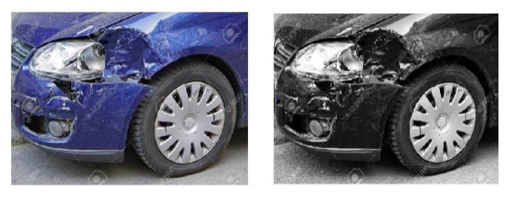
IMPLEMENTATION OF PRE-PROCESSING

Slide 35
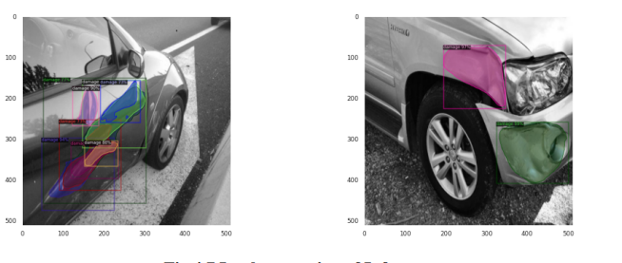
IMPLEMENTATION OF INFERENCE

Slide 36
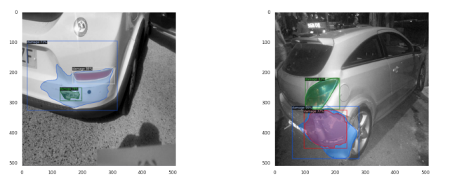
IMPLEMENTATION OF INFERENCE

Slide 37
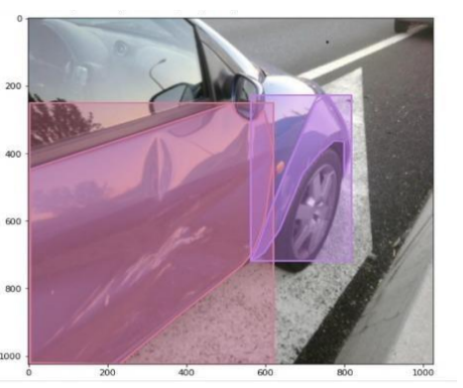
IMPLEMENTATION OF ANNOTATION

Slide 38
REFERENCES
[1] Sreyan Ghosh,Sherwin Joseph Sunny,Rohan Roney (2019), ‘Accident Detection Using Convolutional Neural Networks’,International Conference on Data Science and Communication (IconDSC).
[2] Izzah Amani Tarmizi,Azrina Abd Aziz (2018), ‘Vehicle Detection Using Convolutional Neural Network for Autonomous Vehicles’,International Conference on Intelligent and Advanced Systems (ICIAS)
[3] Najmeddine Dhieb, Hakim Ghazzai,Hichem Besbes, Yehia Massoud (2019), ‘A Very Deep Transfer Learning Model for Vehicle Damage Detection and Localization’,31st International Conference on Microelectronics (ICM)
[4] Naeem Patel, Freddy Poly (2020), ‘Automated Damage Detection in Operational Vehicles Using Mask R-CNN’,Springer.
[5] C.T.Artan,Tolga Kaya (2019), ‘Car Damage Analysis for Insurance Market Using Convolutional Neural Networks’, Springer

Slide 39
REFERENCES
[6] Mahavir Dwivedi, Hashmat Shadab Malik, S. N. Omkar, Edgar Bosco Monis, Bharat Khanna, Satya Ranjan Samal, Ayush Tiwari & Aditya Rathi(2020),‘Deep Learning-Based Car Damage Classification and Detection’,Springer.
[7] Alex Krizhevsky, Ilya Sutskever, Geoffrey E. Hinton(2020), ‘ImageNet classification with deep convolutional neural networks’, Communication of Acm.
[8] Umer Waqas, Nimra Akram, Soohwa Kim, Donghun Lee, Jihoon Jeon(2020), ‘Vehicle Damage Classification and Image Detection Using Deep Learning’,IEEE Canadian Conference on Electrical and Computer Engineering (CCECE).
[9] Kalpesh Patil, Mandar Kulkarni, Anand Sriraman, Shirish Karande (2018), ‘Deep Learning based Car damage classification’,16th IEEE International Conference on Machine Learning and Applications (ICMLA).
[10] Harit Bandi, Suyash Joshi, Siddhant Bhagat, Amol Deshpande (2021), ‘Assessing Car Damage with Convolutional Neural Networks’,International Conference on Communication information and Computing Technology (ICCICT).

Slide 40
CONCLUSION
In this work of Damage analysis of a vehicle in general and insurance reclaim, a system has been designed using CNN and image classification which takes the input from a user as an image to test the severity of the damage, which happens in a sequence of two steps. The first is image classification, here the input provided by the user is processed by the neural network to identify the car, that is if the car is damaged or not. And later in the second step, the flattened input obtained as the output in step 1 is applied for object detection to identify the region and severity of the damage, where the region might be rear, front, or side and severity is divided into minor, moderate, and major. The R-CNN network identifies the severity of the damage, and a report is filed and sent to the user and the insurance firm.

